Slide 1
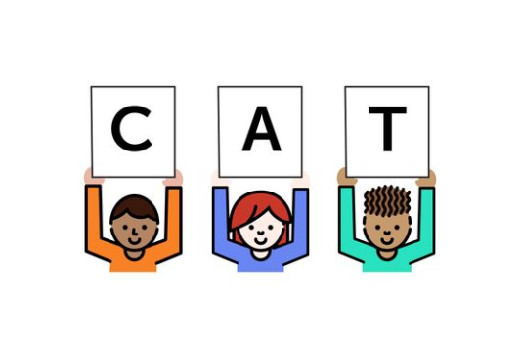
Foundational Skills Mini-Course
Module 1: Foundational Nuts and Bolts
Notes:
This module was last updated on April 2018.
Welcome to the first module of the FS mini-course.

Slide 2


Course Instructors
David Liben,
Senior Content Specialist
Carey Swanson, ELA/Literacy Specialist

Slide 3
About Student Achievement Partners
Student Achievement Partners is a nonprofit organization dedicated to helping teachers and school leaders implement high-quality, college- and career-ready standards. We believe that challenging academic standards are the foundation for improved student outcomes, but that standards alone are not enough. Students will only make dramatic gains in achievement if instructional materials, assessments, and classroom practices are true to the expectations of high-quality, college- and career-ready standards.
Our work is grounded in research and evidence, and we are committed to sharing standards-aligned tools and practices freely with educators across the country. Our website, achievethecore.org, offers hundreds of math and literacy instructional resources for teachers and school leaders.

Slide 4
Goals for This Module
Identify the components of foundational skills.
Distinguish key areas of focus by grade level.
Determine the structure and content of the Foundational Skills Mini-Course.

Slide 5



Information About the Virtual Modules
Online Discussion and Pause Points
Weekly “Connect to Practice” tasks
Opportunities to engage in online discussion.
“Pause points” to engage with content.
Tasks (including role based options) to connect the work to your setting.
Optional recommended reading.
Notes:
This course is set up to be as interactive as possible in a virtual environment.
To allow you time to engage with others and bring the work to your setting, there are two opportunities for each module. One is an online discussion, signaled by the light blue slide and the keyboard image - you can pause the webinar and engage on your platform of choice or do so later in the week. The other is a “connect to practice” task. Templates are provided for these.
Built into the modules are also “pause points” to pause and engage with the content with your colleagues or on your own, and also optional recommended reading. Please feel free to pause at any time to make the experience as individualized as possible.

Slide 6


Why This Course?
Build Your Knowledge
Support Others
Notes:
As we discussed in the course launch, there are two big goals that we have for this course:
The first is that taking this course will build your knowledge as a practioner—either around the content of foundational skills, the implications for practice, or both.
The second is that those of you who support with and work with educators as administrators, coaches, or non-profits will increase your ability to support others—specifically, those who work with our youngest learners as they are building their reading skills.

Slide 7



The Shifts
What makes college- and career-ready standards different?
In ELA/Literacy
Complexity: Practice regularly with complex text and its academic language.
Evidence: Ground reading, writing, and speaking in evidence from text, both literary and informational.
Knowledge: Build knowledge through content-rich nonfiction.
Notes:
Much of our work at SAP is rooted in the Shifts, or what makes college- and career-ready standards different. These are summarized as 1) Complexity: regular practice with complex text and its academic language; 2) Evidence: grounding reading, writing and speaking in text evidence, and 3) building Knowledge through content-rich nonfiction.

Slide 8
Foundational Skills: Not a Shift
Challenges
At times, contested.
The subject of “The Reading Wars.”
Often ignored in PD.
Importance
Research driven and research proven.
Harder than they look.
Critical in teaching ALL students to read.
David Liben’s “Mea Culpa”
Notes:
Foundational Skills are not a Shift. They did not change as a result of the Common Core; they remained the same. Perhaps, however, they should be called the 4th Shift in order to signal their importance.
There are many challenges behind the systematic teaching of Foundational Skills (FS):
At times, they are contested! Not everyone has been informed on their value and purpose, especially those that have experience teaching upper grades. Also, FS are the subject of “the Reading Wars” since whole language aficionados advocate against the systematic teaching of related subskills. Finally, they are seen as simple, easy, and concrete—and, therefore, often ignored in PD.
However, the importance of these skills cannot be overstated. There is a proven research base that teaching these skills systematically works. And those of us who have taught them know that they are harder than they look but are critical in teaching all students to read.
David Liben’s “mea culpa”
Often ignored in PD.
Harder than they look!
Critical in teaching ALL students to read!
Mea culpa!

Slide 9
Word Sort: Test Your Knowledge!
phoneme
grapheme
digraph
onset
segment
http://bit.ly/2Bl9jlf
Notes:
The words on the left in the online word sort are an example of the nuanced and challenging content we’re discussing. If you’d like to test the knowledge of your coworkers right now, or if you need a “do now” for an upcoming staff meeting demonstrating the content needs of this areas of study, use the bitly url to access a word sort using these words and definitions.

Slide 10
Teachers Need PD to Focus on This Work
Teacher Preparation needs to emphasize concepts of language, but usually doesn’t.
Teaching Reading is Rocket Science (Moats, 1999)
Effective instruction about print and its meaning enables teachers to be successful with high needs students.
(Denton, Foorman and Mathes, 2003; Foorman et al., 2006; Torgesen, 2004)
Notes:
Teacher preparation in this area is critical here- but PD time often falls short.

Slide 11
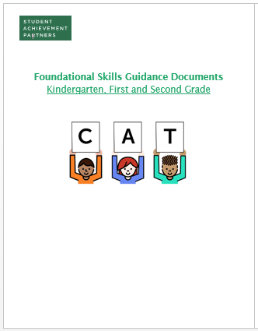
Professional Development Resources for This Course
Guidance Documents – include descriptions of all key content.
Course Modules – outline key content with related tasks.
Office Hours/ Live Webinars – offer feedback and answer questions.
Notes:
We’ve tried to compensate for this through the resources available for the course. This includes the full guidance documents ( https://achievethecore.org/content/upload/Foundational%20Skills%20Guidance%20Document%20Dec%202017.pdf ) as well as weekly modules and often hours.

Slide 12
Online Discussion
Each week when you see this slide and image, it signals a chance to engage in an online discussion. Course instructors, SAP’s Literacy Team, and Core Advocates will be engaging with you in virtual discussions, collecting information about confusions or questions, and using that to plan office hours. This is your first discussion opportunity!

Slide 13
Online Discussion
What do you hope to get out of this course? Use this week’s chat to start a dialogue with other course participants!
Goals for the Course
To improve my own content knowledge!
To support my school/district/organization to purchase curriculum, make a change or better address foundational skills!
To learn new ideas for improving students’ foundational skills!
To coach, develop, or work with others on this content!
Other! (Please specify)
Notes:
This is our first online discussion for the course. We want to hear more about why you are taking the course and what you hope to gain. This will help us target your needs in office hours, and allow you time to connect with others across the country doing the same work.
Try to select which of the choices best match your goals.

Slide 14
Components of Foundational Skills
Common Core Standards
Print Concepts
Phonological Awareness
Phonics and Word Recognition
Fluency
Notes:
We’re now going to move into the content goals of today’s module. The Common Core Standards for Foundational Skills consist of four categories, listed here. We’ll summarize each one and give some grade-level-specific guidance.
If you are working in a state that has adapted state specific standards, rest assured that there is a great deal of overlap between the guidelines we offer and your state standards. While you can investigate this more closely state-by-state, the vast majority of states have kept true to most of the content of the common core.

Slide 15
Print Concepts
2
K
1
Complete
Description:
The organization and basic features of print.
Kindergarten:
Knowledge of words – they use letters to represent spoken words, they go from left to right, top to bottom, they are separated by spaces on the page.
Knowledge of letters – how they look in print and the sounds they make.
First grade:
Knowledge of sentences – capitalization and punctuation.
Notes:
Print concepts refer to the organization and basic features of print. It is important to note that this is primarily a kindergarten set of standards. In first grade, only sentence knowledge is listed; by second grade, this should be complete.
In kindergarten, print concepts consist of knowledge of words (they use letters to represent spoken words; they go from left to right, bottom to top; they are separated by spaces on the page) and knowledge of letters.
Knowledge of letters, including the sounds that they make, is critical to reading success. This should be a large area of focus in early K.

Slide 16
Considerations for Teaching Print Concepts
Kindergarten
First Grade
Familiarity will vary based on past experience.
Should not take much teaching time in isolation.
Reinforce with all book-based experiences, including read aloud.
Very limited teaching time – embed in other instruction.
Notes:
Students vary in terms of their background knowledge of print concepts when they walk in the door. Some may have them secure from day one, while others have much to learn. However, this can be taught quite quickly and often connected to other content. Outside of letter knowledge, this should not take much instructiional time. Here are some guidelines for teaching print concepts.

Slide 17

Examples of Reinforcement
“Boys and Girls, I’m going to read you this letter from the principal. Let’s see – here’s the top line where I begin.”
“Whoops, I skipped this section, I see there are still words under the picture before I move to the next page.”
Notes:
Concepts of print can be reinforced directly and indirectly every time students are exposed to print. Here are some basic examples of this.

Slide 18
Phonological
Awareness
K
1
2
Complete
Description:
Understanding of spoken words, syllables, and sounds (phonemes).
Kindergarten:
Knowledge of rhyme, syllables, and onset/rime
Knowledge of phonemes – identify/pronounce the initial, medial, and final sounds of consonant-vowel-consonant words; add/substitute phonemes.
First grade:
Knowledge of syllables – blending and segmenting.
Knowledge of phonemes – distinguishing short/long vowels, isolating/identifying initial, medial, and final sounds.
Notes:
Phonological awareness is also a K and 1 area of focus, with a large emphasis in K. Phonological Awareness consists of an awareness of spoken words, syllables, and sounds, or phonemes.
We’ll spend all of Module 2 talking in depth about this critical area of focus.

Slide 19
Phonics and Word
Recognition
K
1
2
Description:
Know and apply grade-level phonics and word analysis skills in decoding words.
Kindergarten:
Knowledge of phonemes/sounds connect to knowledge of graphemes/spelling.
First grade:
Knowledge of sound and spelling patterns for digraphs, long vowels, some endings/irregular spellings.
Decoding regularly spelled one syllable and basic patterned two syllable words.
Second grade:
Knowledge of sound and spelling patterns for vowels and vowel teams and common regular and irregular spelling.
Decoding regularly spelled two syllable words and common prefixes/suffixes.
All – Reading/Recognizing grade level high-frequency words.
Notes:
Phonics and word recognition represents a huge focus for instruction for second grade, first grade, and kindergarten as soon as letter recognition is secure.
Phonics begins with connecting knowledge of phonemes, or sounds, to graphemes, or letters/groups of letters that represent sounds. It builds through first grade and second grade with the addition of more complicated sound and spelling patterns and high-frequency words, such that students are able to read and decode more and more words on their own.
This instruction is critical, and we’ve allocated two modules, Modules 3 and 4, to phonics instruction.

Slide 20
Fluency
K
1
2
Description:
Read with sufficient accuracy and fluency to support comprehension.
Kindergarten:
Reading emergent reader texts with purpose and understanding.
First grade:
Reading emergent reader texts with purpose and understanding.
Reading orally with accuracy.
Second grade:
Reading grade-level text* with purpose and understanding.
Reading orally with accuracy, rate, and expression.
*Grade level complexity requirements begin in 2nd grade
Notes:
Fluency is also a category of instruction across K, 1, and 2. In kindergarten the focus consists of reading with purpose and understanding. In first grade, the focus turns to reading accurately and, in second grade, students should be reading with accuracy, rate, and expression. Note that text complexity requirements also begin in the second grade.
Fluency is built through reading. We’ll be referring to this in two modules: Module 5 focuses on early reading and Module 6 focuses on practice with some more specific fluency content.

Slide 21
Print Concepts
K
1
2
Complete
K
1
2
Phonological Awareness
Complete
Phonics and Word Recognition
K
1
2
Fluency
K
1
2
Notes:
Here is a visual summary of the four areas of foundational skills. The color coding helps allocate grade-level priorities. Remember that instructional time is not in any way equal for these four areas—print concepts should take minimal time outside of letter recognition in K, while phonological awareness and phonics are going to take targeted daily instruction. Fluency should be prioritized when accuracy and automaticity are secure.

Slide 22
Pause Point Slide
Throughout this course, slides with the blue pause button will be opportunities to pause and engage with the content.
Listen to the task, then pause the webinar. Our first opportunity is on the next slide.
Work together with your colleagues!
Notes:
A reminder that throughout the course there will be the chance to pause and engage with the content. Listen to the task, then pause the webinar. Our first opportunity is on the next slide. If you are working in a group, engage with your colleagues!

Slide 23
Task: Identify the Appropriate Grade Level
Timed reading of grade-level text. | 2nd grade fluency
Identifying words that rhyme with a stated word. | K PA
Identifying letters and their most common corresponding sound. | K print concepts
Decoding words with irregular sound and spelling patterns. | 2nd grade phonics
Determining appropriate end punctuation for sentences. | 1st grade print concepts
Identifying the long vowel sound in the middle of a one syllable word. | 1st grade PA
Notes:
Use the first page of your handout and/or the Common Core Standards to map each task to the appropriate grade level and content. Identify whether it is PA, Print Concepts, Fluency, or Phonics/word recognition, and the grade most appropriate for the task. When you’re done, press play on the webinar.

Slide 24

Content in This Course
Module 2: Phonological Awareness
Modules 3 and 4: Phonics
Module 5: Foundational Reading
Module 6: Practice and Reading Fluency
Module 7: Assessment
Notes:
We’ve mentioned the varied content that this course will cover. Here is a summary. As you can see, the standards buckets are covered in four of the upcoming modules, as marked with green text. Specifically PA is Module 2, Phonics is Modules 3 and 4, and Fluency is part of Module 6.
We’ll also be spending time looking at what early reading consists of and texts that are most supportive of this work in Module 5, other opportunities for student practice in Module 6, and assessment in module 7.

Slide 25
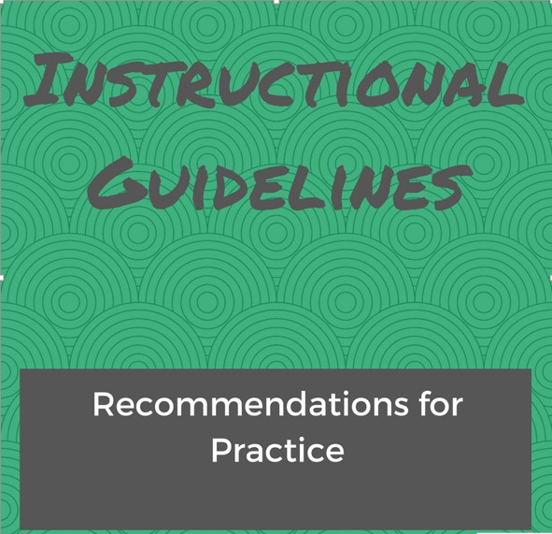
Notes:
It is not just the content of what early elementary teachers are teaching that we hope to address in this course—it is also important to give some recommendations for practice.

Slide 26
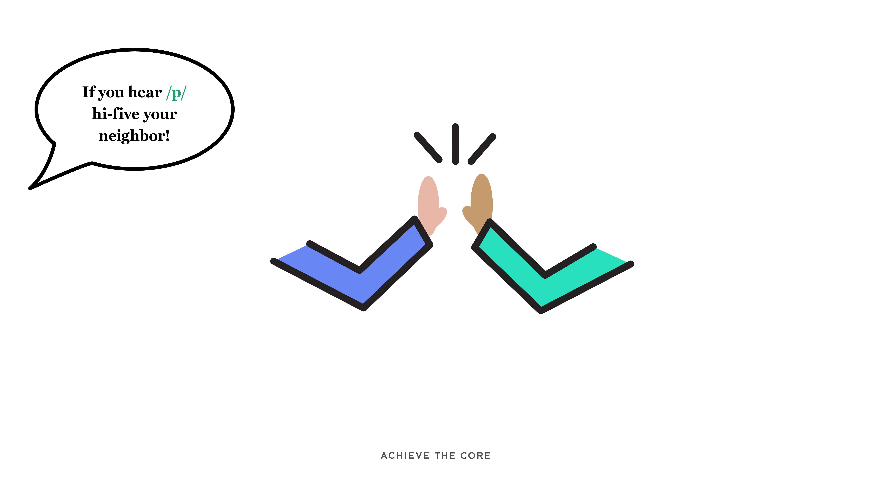
Effective Enhancements: Use songs, games, and activities to make learning fun!
Keep effective enhancements in mind throughout all of the modules! A sample list is provided in the guidance documents, and the course handout.
Notes:
Our youngest students should be learning through fun, engaging tasks. Effecitve enhancements can do the following:
Make a task into a game
Add movement
Add music
Make it FUN!
Keep effective enhancements in mind throughout all of the modules! A sample list is provided in the guidance documents, and the course handout.

Slide 27
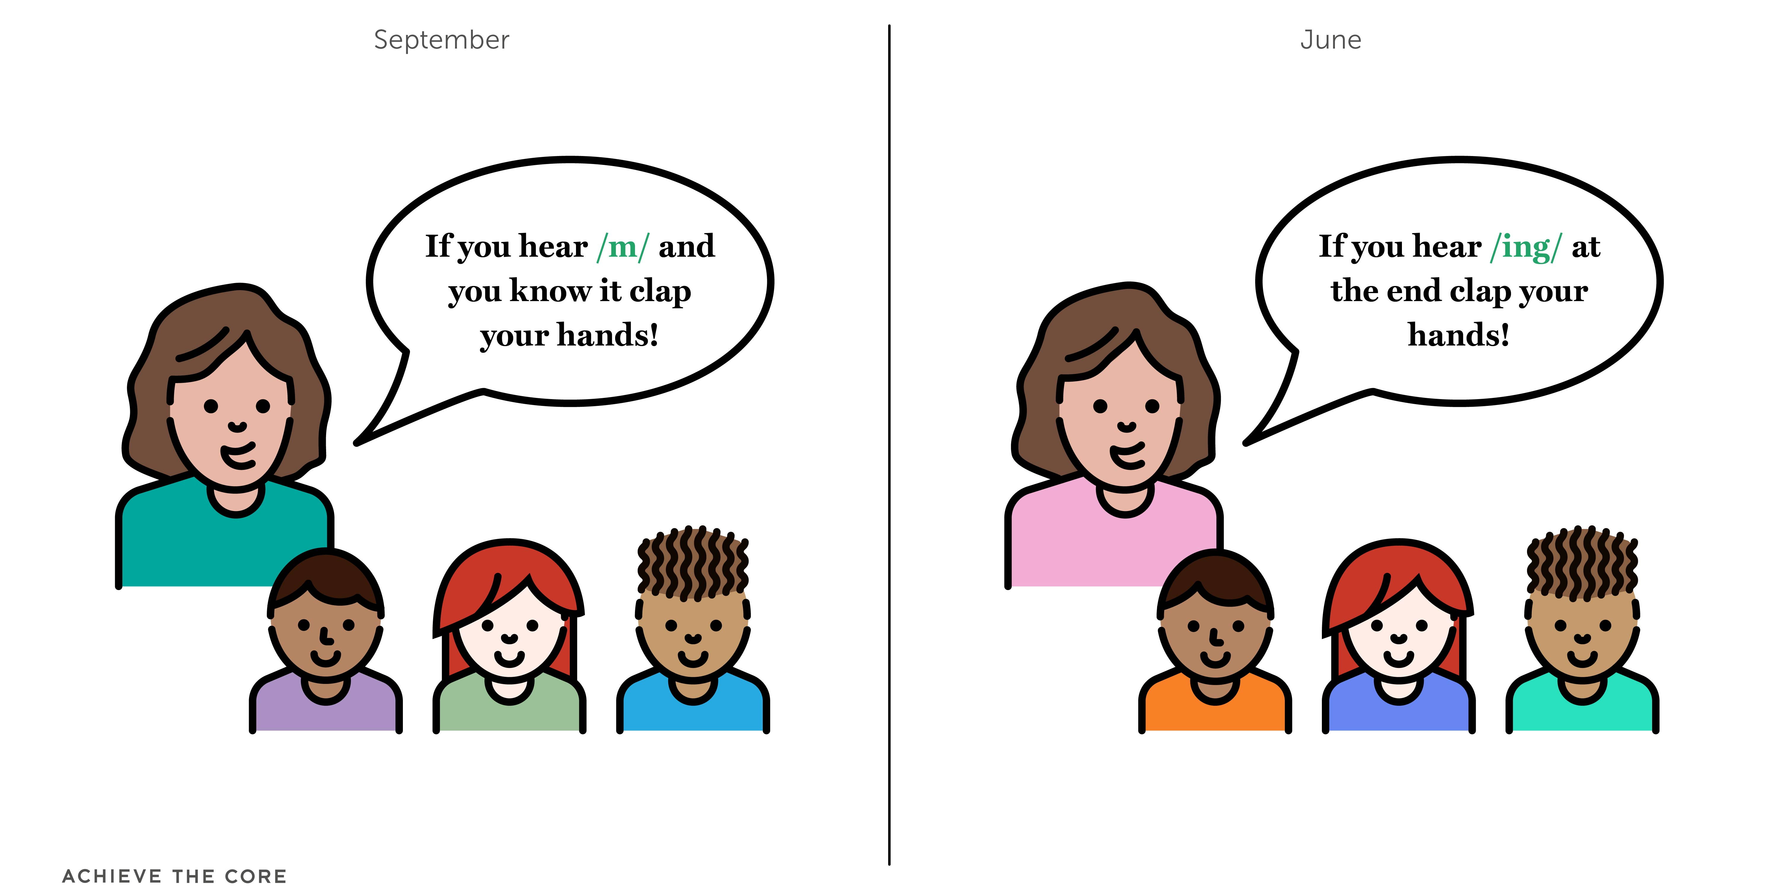
Teacher Note
Students don’t need to repeatedly practice what they’ve learned already.
Retire old content or repurpose it to reflect new learning.
/ng/
Notes:
While having fun is important, it is also important to make use of instructional time. So, vary the types of tasks you are asking students to do based on what they are currently learning. Repurpose old content to reflect new learning.

Slide 28
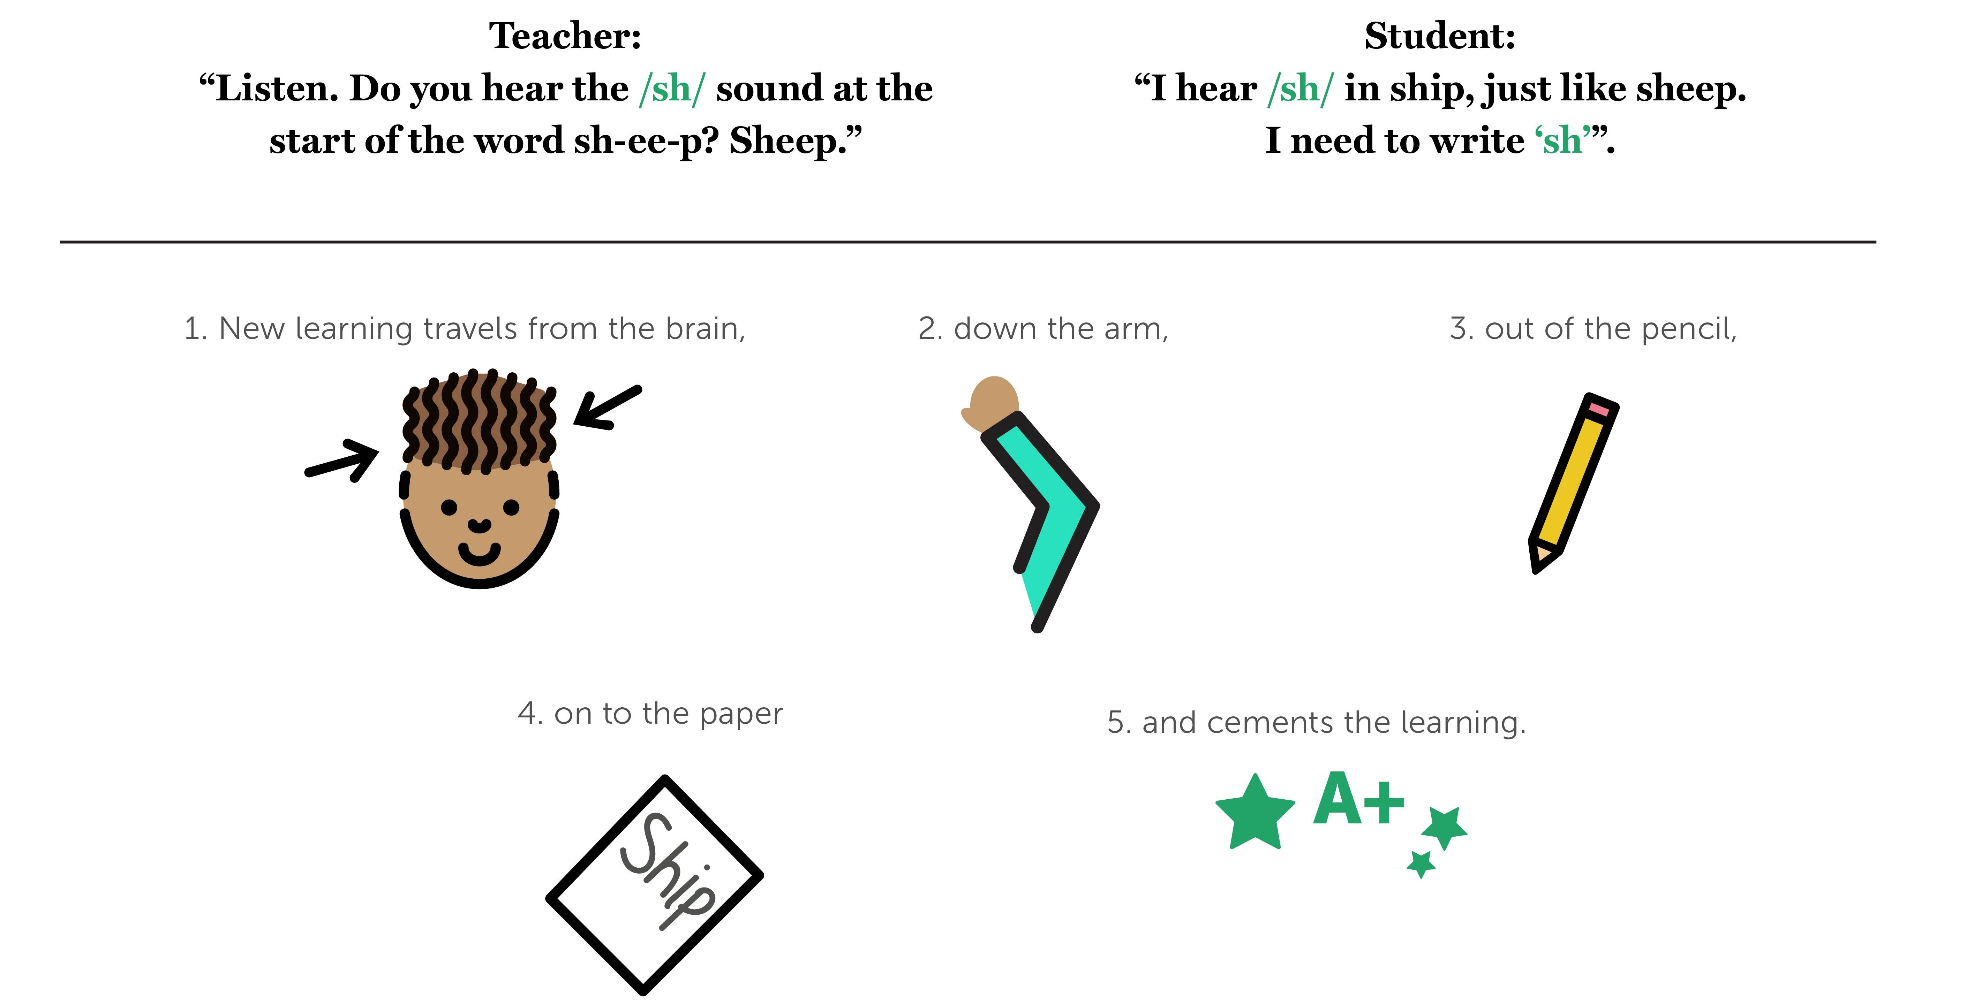
Practice, Practice, Practice: Students need multiple opportunities to practice new skills orally and in reading/writing!
Notes:
Another key guideline is the importance of practice. Students need multiple “at bats” to practice the skills they are learning. This should happen orally as well as in writing. We’ll give more guidance in Module 6 but, as you are digesting the content each week, please consider how fluid this instruction must be: the teacher provides an explicit model and students practice out loud and in reading and writing throughout each period of instruction.

Slide 29
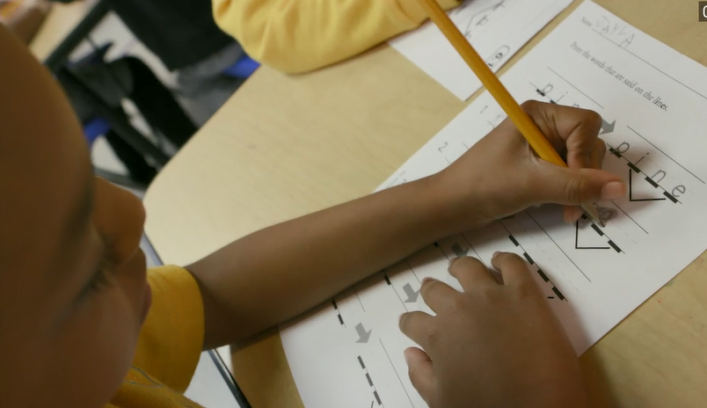
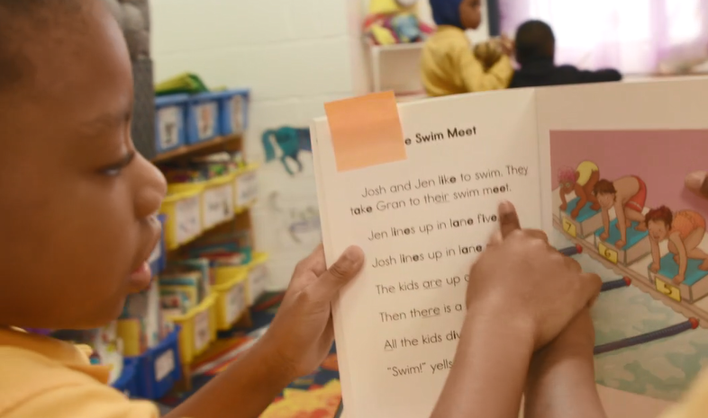
Practice IN and OUT of context
Students need to practice new skills independently AND context the new skill to reading.
*We’ll dig into this guidance during Module 5!
Notes:
Another guideline connected to practice is that there is value and importance in practice that is done both in and out of context. That means practicing skills in isolation AND connecting them to text. We’ll spend more time on this guidance in Module 5, but as students are acquiring these crucial skills we want to be sure that they are connecting them directly to use in text.

Slide 30
Keeping the End in Mind
Notes:
All of this work is outcome oriented: we are keeping the desired end in mind, which is that our students become happy, engaged readers and writers.

Slide 31

Proficient Reading Is Our End Goal
We work from the lens of what works for a skillful reader!
We consolidate and synthesize research-based best practices.
We identify key takeaways for instruction of early readers.
Notes:
The guidance we offer, and the content we are sharing, come from research that focuses on the habits of proficient readers.
We are working from the viewpoint of what we know about what skillful readers do. We have consolidated and synthesized research based on best practices, and do our best to present the information in an accessible way, with limited jargon and as many direct connections to practice as possible. And, to that end, we identify and share key takeaways that you can use practically in instruction.

Slide 32
Experts and Works Cited
Work:
Common Core Standards
Beginning to Read
National Reading Panel
Researchers:
Marilyn Adams
Linnea Ehri
Deb Glaser
Louisa Moats
David Paige
Mark Seidenberg
Tim Shanahan
Notes:
If you’d like to know more about the knowledge base we are pulling from or the researchers we have studied, you can take a look at this source list.
Note that we drew a great deal on Marilyn Adams. Her book, Beginning to Read, and much of her research is referenced throughout.

Slide 33
Connect to Practice Task
Each week will include a task that connects to your practice. We encourage you to engage with your colleagues to complete the task in order to extend your learning and connect to your practice.
Option A will be a task that is specific to a school setting. Option B will be a task that can be done for those that work in an educational organization or district.
If you use a core program for phonics, please use that program for assignments. If not, you may use an OER resource such as Core Knowledge Language Arts’ Skills Strand.

Slide 34
Module 1: Connect to Practice Task
Option A:
Use the “Features of a Structured Foundational Skills” Checklist to evaluate your school/classroom/ district’s approach to foundational skills.
Option B:
Use the “Features of a Structured Foundational Skills” Checklist to evaluate an open resource.
Options:
CKLA
Expeditionary Learning
Your choice based on access.
Notes:
This week’s practice options are differentiated based on whether or not you are school-based. If you are in a school or work closely with a school, you’ll find a template to evaluate your program against the criteria that David Liben shared when we launched the course.
If you are not school-based, you can use this same template using an open source curriculum; two common ones are hyperlinked here, or you can choose another program based on your access. You’ll want to find the scope and sequence of skills taught for this work. Note that you may have the opportunity to use this resource for future assignments.

Slide 35

Recommended Reading
http://bit.ly/2nfq4w2
Notes:
Recommended reading for this week focuses on what the Common Core standards really say about ELA/literacy in K, and addressing the Myths vs Facts of instruction in this area.
The next few slides are also included in the Powerpoint version of this module, and include information about other tools and resources related to Student Achievement Partners as an organization, the resources we house on our website, Achieve the Core, and our team of engaged teachers and leaders, Core Advocates.

Slide 36



About Achieve the Core
Visit achievethecore.org to find:
Professional Learning Content
PD modules
Research
Aligned Blog
Tools for Planning and Reflection
Instructional Practice Toolkit
Instructional Practice Guide
Lesson Planning Tool
Focus Documents
Alignment rubrics and adaptation guidance
Classroom Resources
Math and ELA lessons
Mini-assessments
Writing resources
Coherence Map
Academic Word Finder

Slide 37
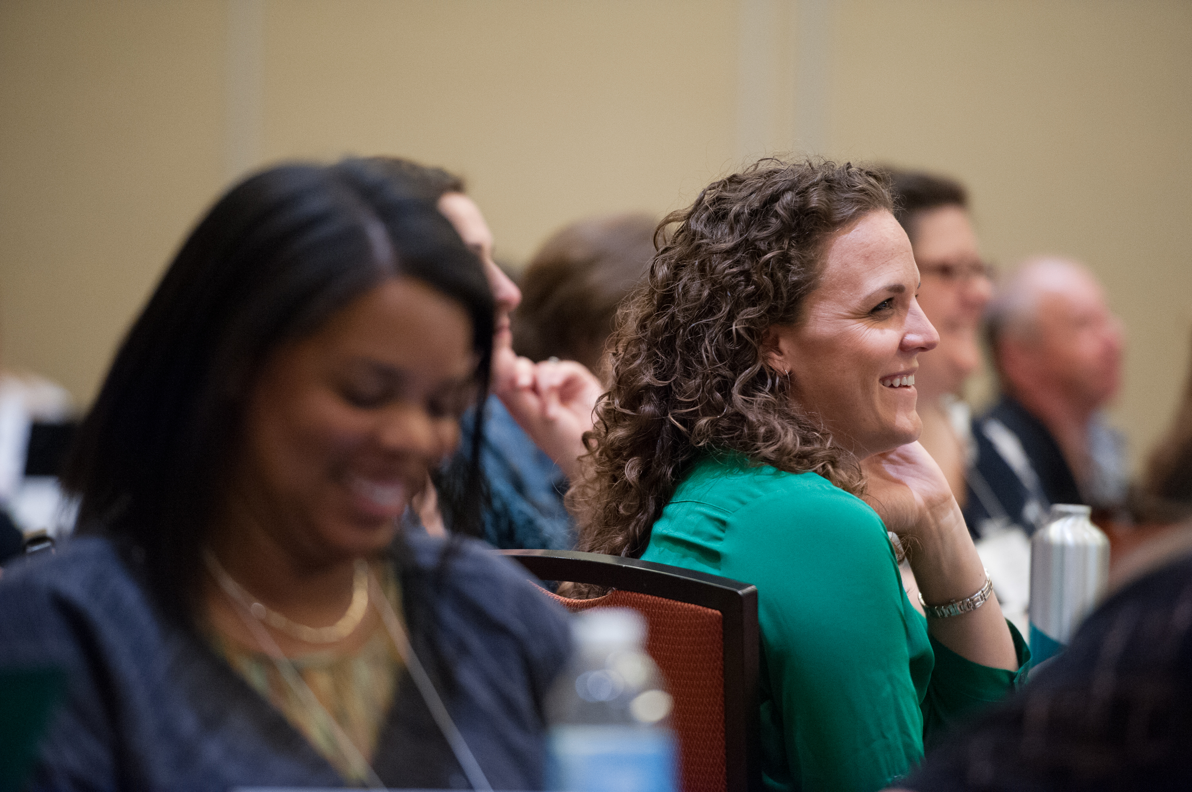
The Core Advocate Network
Who are the Core Advocates?
Core Advocates are educators who:
Believe in the potential of high-quality standards grounded in evidence to prepare all students for college and career.
Understand and embrace the Shifts in instruction and assessment required by college- and career-ready standards.
Are eager to support their colleagues and communities in understanding and translating the Shifts into instructional practice.
What do Core Advocates do?
As instructional advocates, Core Advocates lead other educators in their communities in understanding the Shifts, as well as sharing practices aligned to the Shifts and the standards. Among other actions, Core Advocates:
Lead professional development sessions and professional learning communities.
Create, refine, and share standards-aligned resources with the field.
Advocate for high-quality instruction, instructional resources, and professional learning.
Use and provide feedback on high-quality instructional tools and resources.
How can I get involved?
Join the Core Advocate Network by taking the Core Advocate survey at: www.achievethecore.org/ca-signup
Email coreadvocates@studentsachieve.net with any questions.

Slide 38




Stay Connected
Subscribe for email updates on achievethecore.org
Follow us on social media:
Facebook: facebook.com/achievethecore
Twitter: twitter.com/achievethecore
Pinterest: pinterest.com/achievethecore

Slide 39
Thank You!

